Slide 1
CIST 2500
dispersion and the z
Notes:
This is the beginning of week 2. Welcome!

Slide 2
Admin
Notes:
Not a ton of administration to cover.
This is the first full week and so we’ll be getting to know each other. I’ve taken a ton of the feedback from last semester and used it here. Mostly I was told to:
Abandon the book’s test banks (they were bad and full of mistakes).
Be more purposeful with content (as in, strip it of as much fluff as possible).
Make the homeworks about the act of stats, not the terms.
Give a full week.
_____________________
Is the professor teaching this for the first time? If so, be on guard. We are very human.
Does the promised content match up to the promises (as in, does the stuff like attempts, etc, match up with what was expected?).
Can you find the publisher’s website for the course materials?

Slide 3
Describe
Compare
Relate
Notes:
And so, last Thursday, we mostly all sat here while I tried to talk about the potential of stats, to describe what we’re going to learn and what we’ll be able to do. If you remember, I said stats typically does 3 things.
We describe data, compare things, or relate (correlation, regression models, etc).

Slide 4
Describe
Notes:
So for this week, we’re going to focus on “describing” and that sounds boring but it’s the basic first step we almost always take.

Slide 5
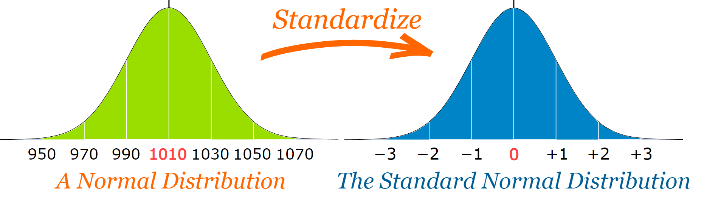
Normal Curve
Notes:
A normal curve is a standardized one.
Consider the following: The SND allows researchers to calculate the probability of randomly obtaining a score from the distribution (i.e. sample). For example, there is a 68% probability of randomly selecting a score between -1 and +1 standard deviations from the mean (see Fig. 4).
Normal distribution could be anything and that’s what makes standardizing so useful.
We just constantly go back to this model to help us make sense of what our data are saying.

Slide 6
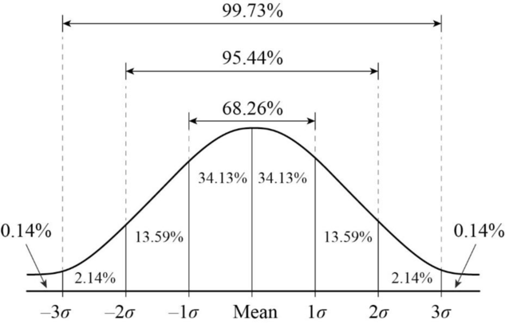
Normal Curve
Notes:
Central Tendency is why this works. We want data to look like this, to be normally distributed.

Slide 7


Slide 8
Normal Curve
Notes:
Central Tendency is why this works. We want data to look like this, to be normally distributed.

Slide 9
CENTRAL
TENDENCY
Notes:
The center or typicality of a distribution. The three most common measures of central tendency are mean, median, mode.
This central tendency will have a lot more context once we talk about skewness and kurtosis.

Slide 10
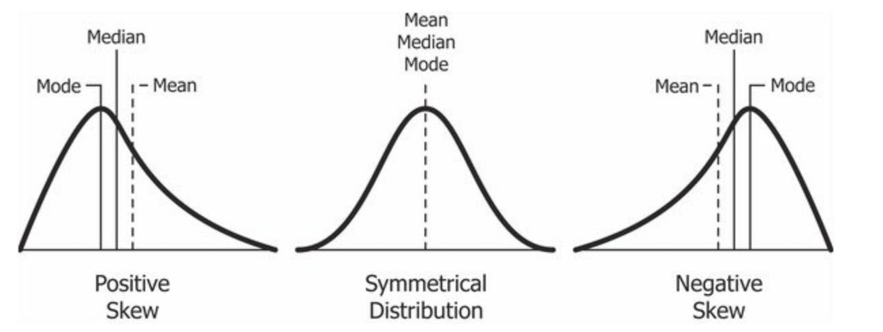
Normal Curve
Notes:
We perform these initial descriptive measures in order to understand if our data looks like this. Mean, Median, and Mode should roughly be the same. We want symmetry.
We’ll get into this at a later date (when we talk about sampling) but I wanted you to know why we’re starting here.

Slide 11
CENTRAL
LIMIT
THEOREM
Notes:
If repeated random samples of size n are taken from a population with a mean or mu and a standard deviation, the sampling distributiuon of sample means will have a mean equal to mu and a standard error equal to standard deviation over the square root of N. Moreover, as n increases the sampling distriubution will approach a normal distribution.
This is a fancy way of saying, “More data means less moves with new data.”
Example: course stuff, GPA, tests, final grades.

Slide 12
population v sample
Notes:
This could be a starting point but let’s hold off on this a bit.
What you should know about this, I’ll cover as it comes up this week.

Slide 13
so now what?
Notes:
This could be a starting point but let’s hold off on this a bit.
What you should know about this, I’ll cover as it comes up this week.

Slide 14
dispersion!

Slide 15
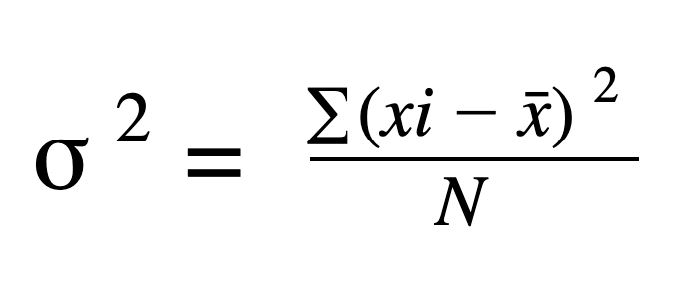
variance

Slide 16
Deviations
Σ(x-x̄)

Slide 17
Should always = 0

Slide 18
Mean Deviation
(|Σ(x-x̄)|) /n

Slide 19
need to standardize

Slide 20
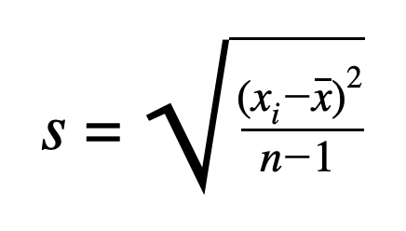
Standard Deviation

Slide 21
n vs n-1
Notes:
use N-1 for samples, and N when population is known.
It essentially increases accuracy
When calculating the std of a sample, they change the n in the demonimator to n-1. This slight reduction in the denominator results in a larger standard deviation. One that better reflects the true standard deviation of the population.

Slide 22
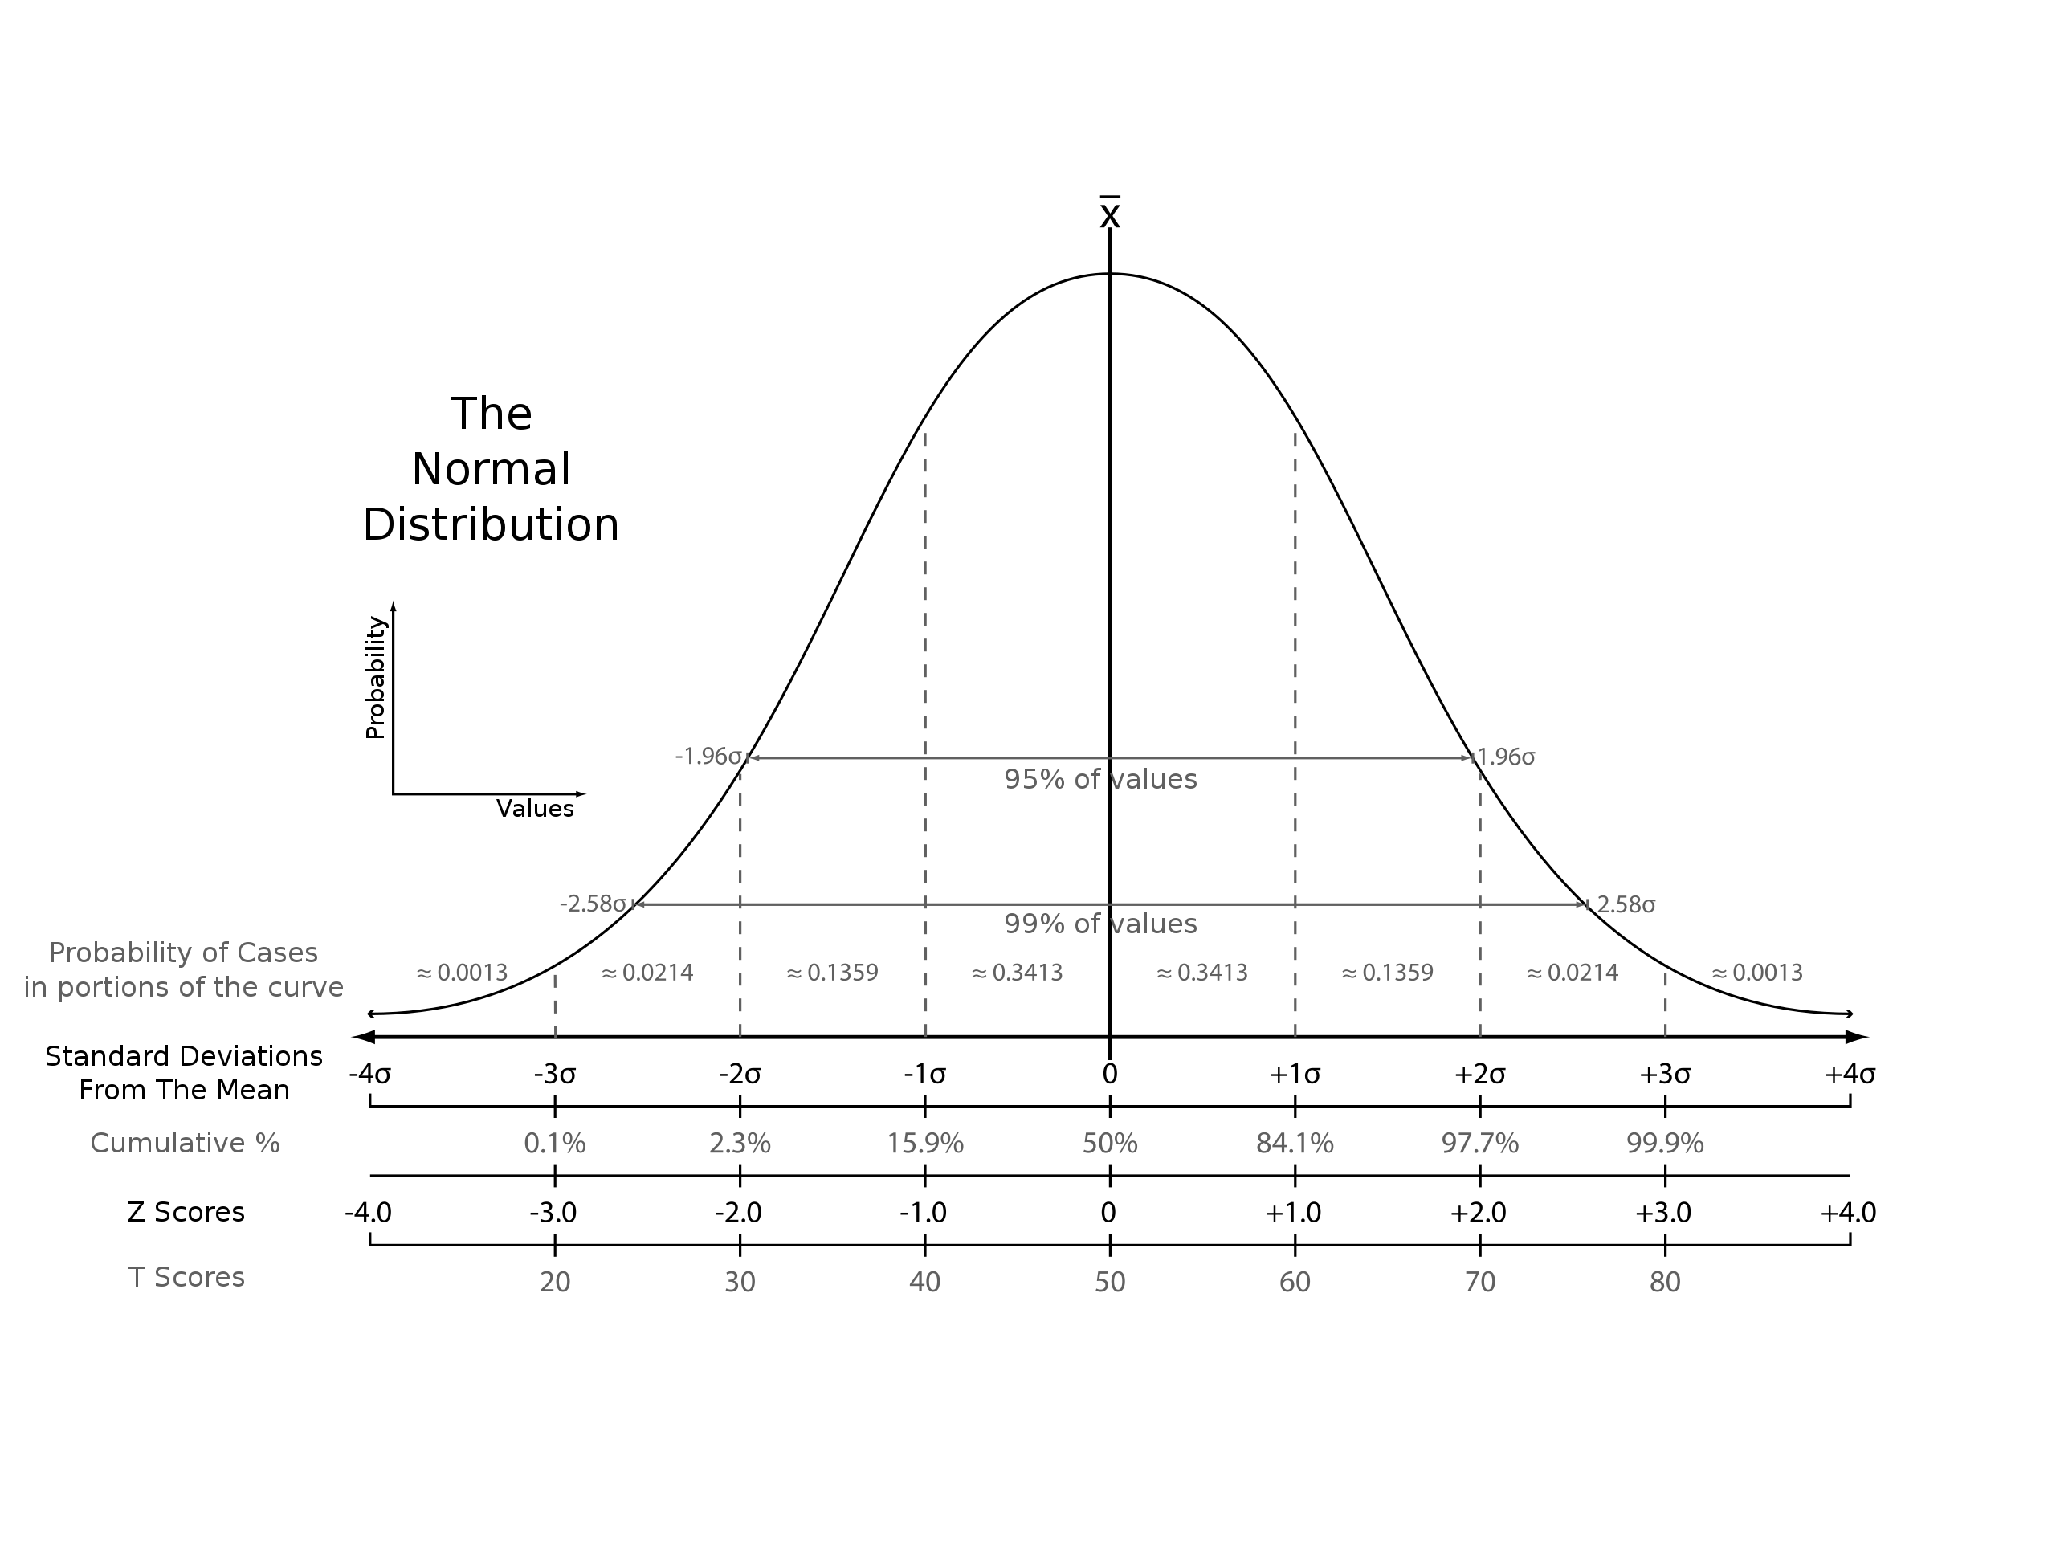
Z-Scores
Notes:
The value of the z-score tells you how many standard deviations you are away from the mean. If a z-score is equal to 0, it is on the mean.

Slide 23
ok, so now what?
Notes:
use N-1 for samples, and N when population is known.
It essentially increases accuracy
When calculating the std of a sample, they change the n in the demonimator to n-1. This slight reduction in the denominator results in a larger standard deviation. One that better reflects the true standard deviation of the population.

Slide 24
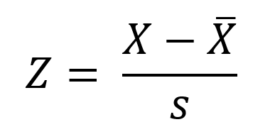
Z-Score
Notes:
The value of the z-score tells you how many standard deviations you are away from the mean. If a z-score is equal to 0, it is on the mean.
There is a table on page 764 with z-scores. Let’s do a few.
It is a composite score.

Slide 25
and we get even weirder…
Notes:
One of the things to worry about with z-scores is that you end up with a value…and so we have to refer to a chart.

Slide 26
example wednesday
Notes:
I mean computers…

Slide 27
Bye!
Notes:
See you Thursday!!

